Slide 1

Mobile Learning Application Development
1
Presented By:
Rakib Hossen
Assistant Professor
Dept. of Cyber Security Engineering (CySE), UFTB

Slide 2
Flutter Widget
In Flutter, widgets can be grouped into multiple categories based on their features, as listed below −
Platform specific widgets
Layout widgets
State maintenance widgets
Platform independent / basic widgets

Slide 3
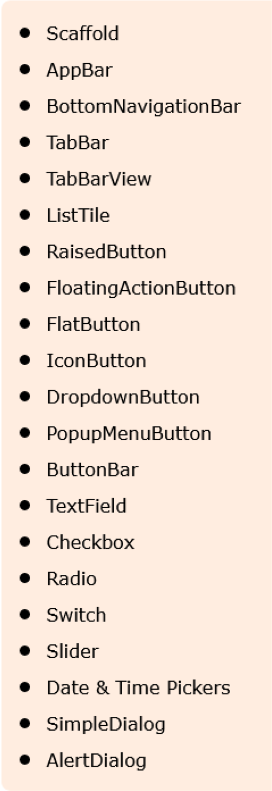
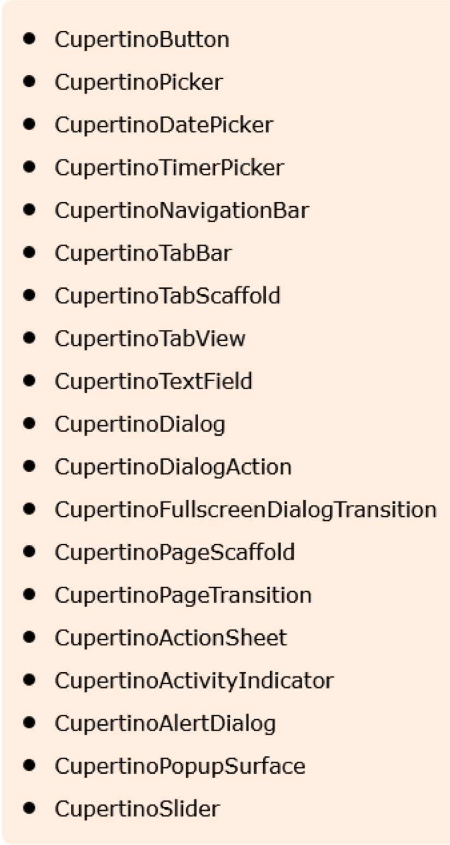
Platform specific widgets
Flutter has widgets specific to a particular platform - Android or iOS.
Android specific widgets are designed in accordance with Material design guideline by Android OS. Android specific widgets are called as Material widgets.
iOS specific accordance
widgets with
are designed in Human Interface
Guidelines by Apple and they are called as Cupertino widgets.

Slide 4
Layout widgets
In Flutter, a widget can be created by composing one or more widgets. To compose multiple widgets into a single widget, Flutter provides large number of widgets with layout feature.
Container − A rectangular box decorated using BoxDecoration widgets with background, border and shadow.
Center − Center its child widget.
Row − Arrange its children in the horizontal direction.
Column − Arrange its children in the vertical direction.
Stack − Arrange one above the another.

Slide 5
State maintenance widgets
State: The State is the information that can be read synchronously when the widget is built and might change during the lifetime of the widget.
In Flutter, all widgets are either derived from
StatelessWidget or
StatefulWidget.

Slide 6
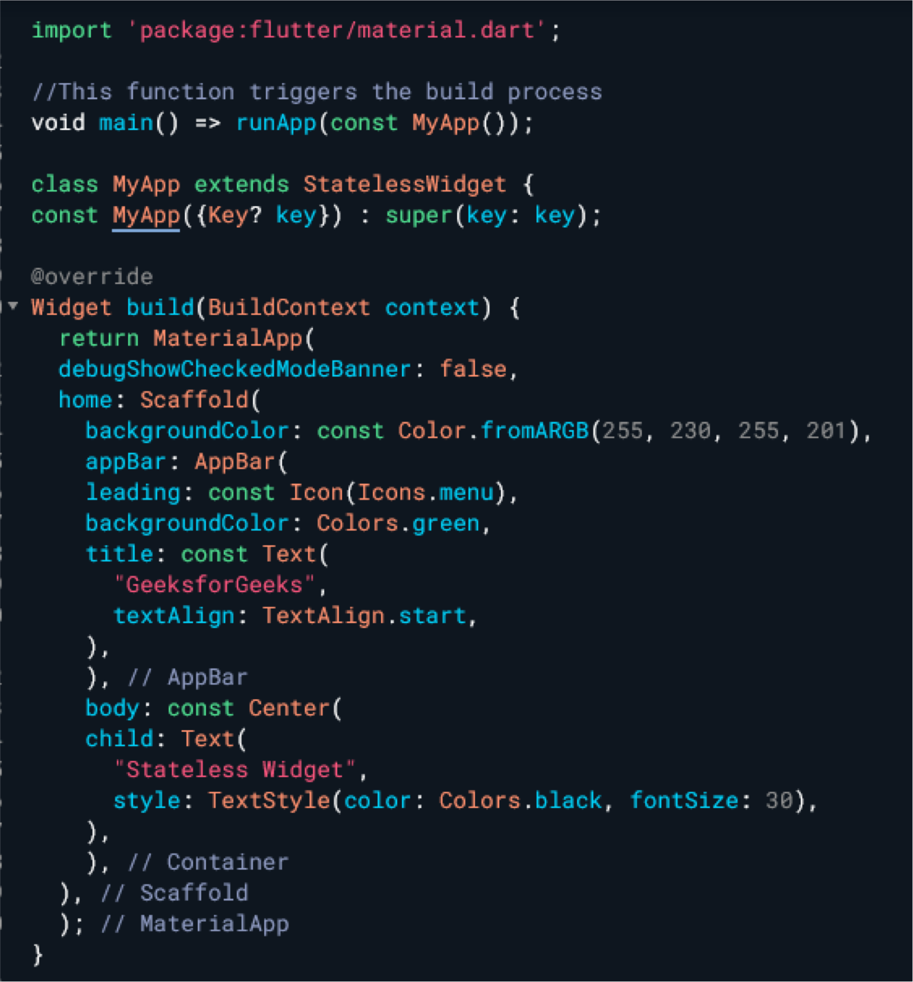
Stateless Widget
A Stateless Widget is a widget that doesn't maintain any mutable state.
Once created, the properties of a stateless widget cannot be changed. It remains constant over time.
Stateless widgets are generally used for parts of the UI that don't change dynamically based on user interactions or other factors.

Slide 7
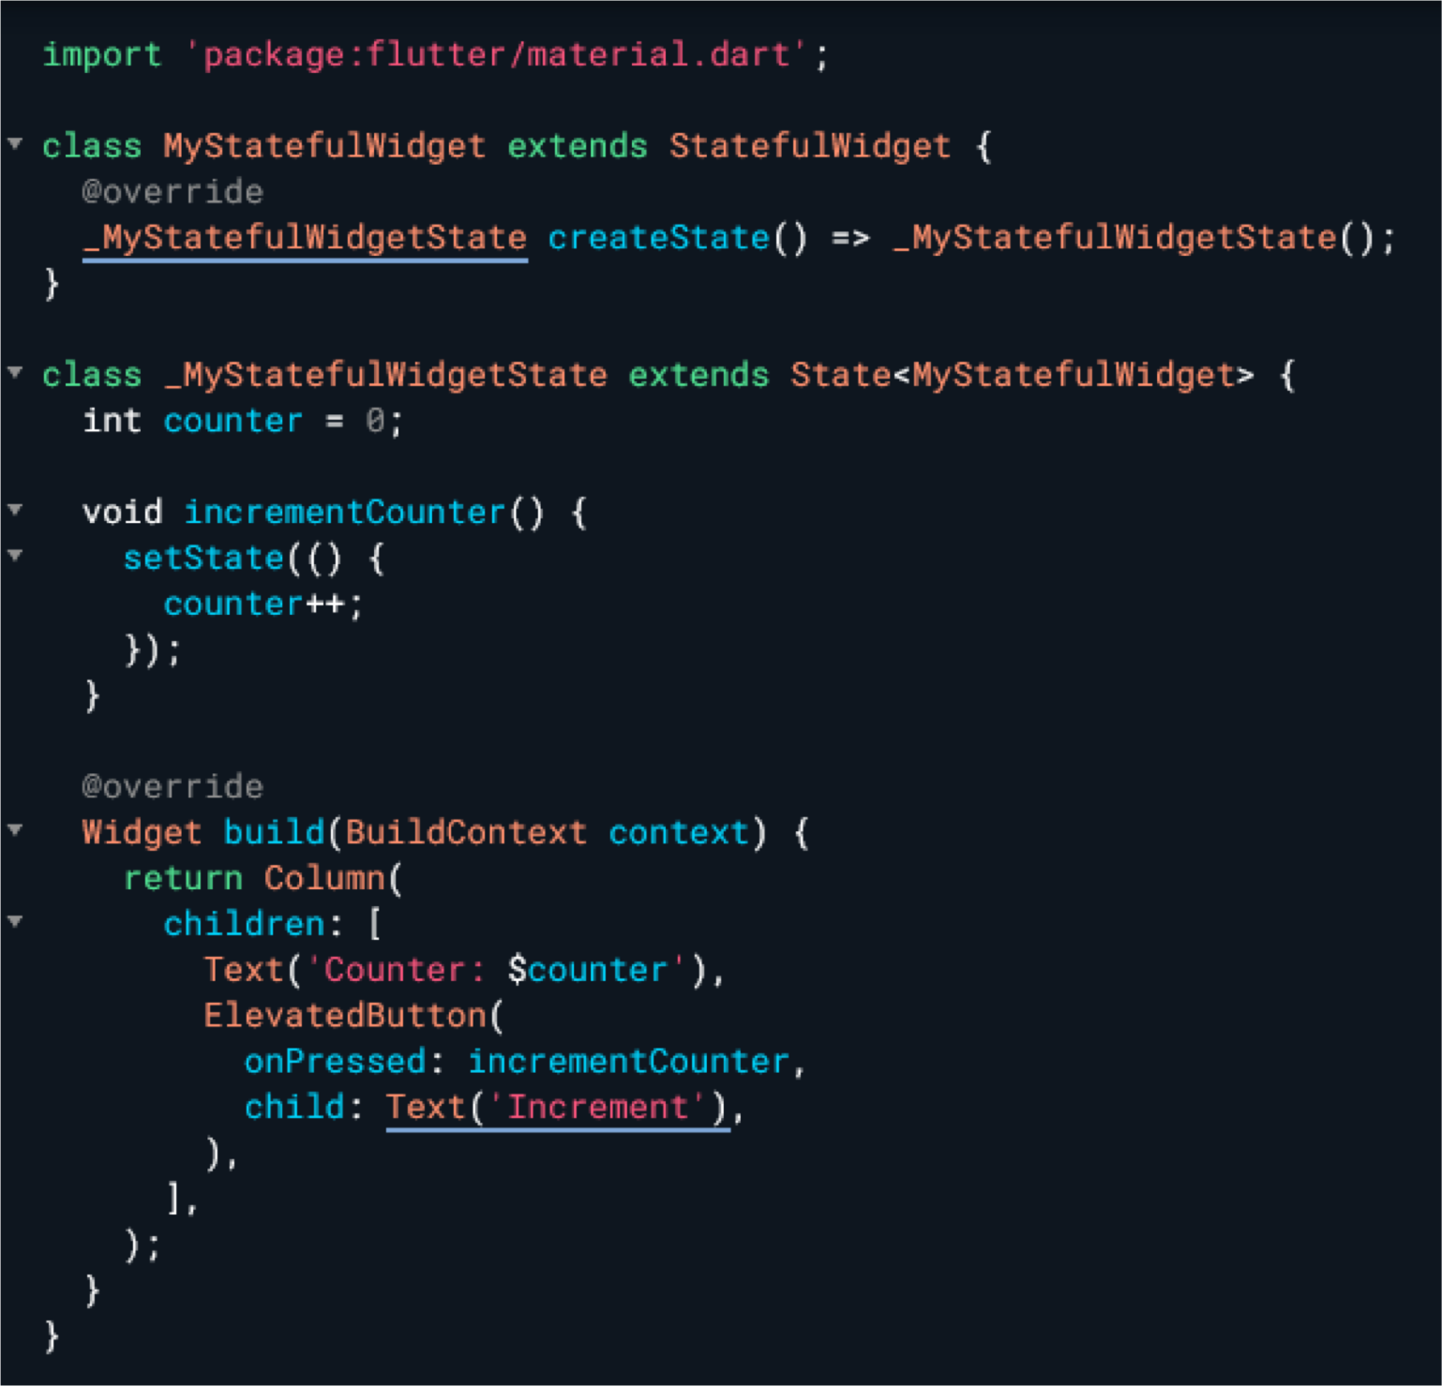
Stateful Widget
The widgets whose state can be altered once they are built are called stateful Widgets.
These states are mutable and can be changed multiple times in their lifetime.
This simply means the state of an app can
change multiple times with different sets of variables, inputs, data.
Below is the basic structure of a stateful widget. Stateful widget overrides the createState() method and returns a State.
It is used when the UI can change dynamically

Slide 8
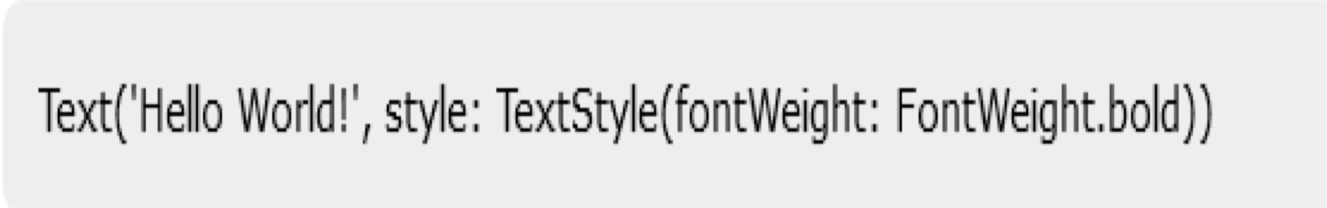
Platform independent / basic widgets
Flutter provides large number of basic widgets to create simple as well as complex user interface in a platform independent manner.
Text
Text widget is used to display a piece of string. The style of the string can be set by using style property and TextStyle class. The sample code for this purpose is as follows −

Slide 9
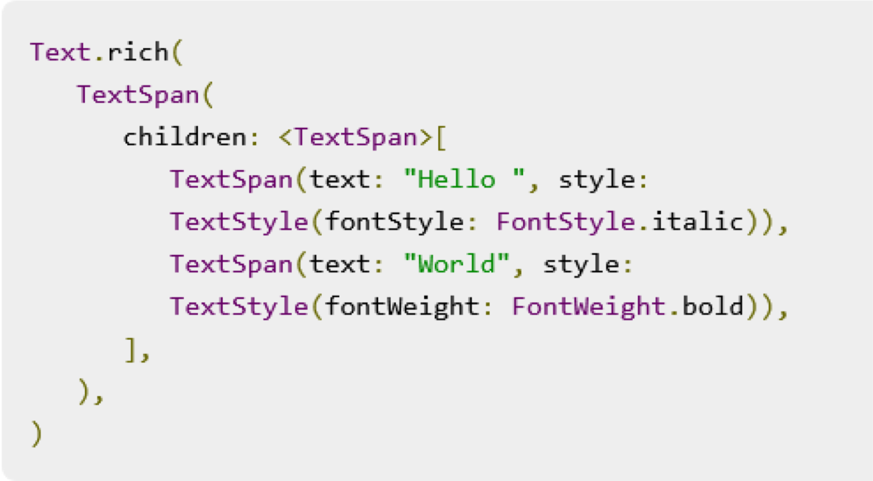
Text
Text widget has a special constructor, Text.rich, which accepts the child of type TextSpan to specify the string with different style. TextSpan widget is recursive in nature and it accepts TextSpan as its children.

Slide 10

Text
The most important properties of the Text widget are as follows −
maxLines, int − Maximum number of lines to show
overflow, TextOverFlow − Specify how visual overflow is handled using TextOverFlow class
style, TextStyle − Specify the style of the string using TextStyle class
textAlign, TextAlign − Alignment of the text like right, left, justify, etc., using TextAlign class
textDirection, TextDirection − Direction of text to flow, either left-to-right or right-to-left

Slide 11

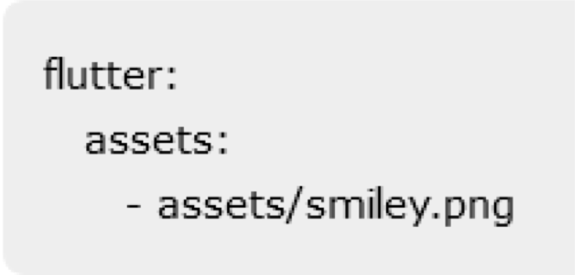
Image
Image − Generic image loader using ImageProvider
Image.asset − Load image from flutter project’s assets
Image.file − Load image from system folder
Image.memory − Load image from memory
Image.Network − Load image from network
The easiest option to load and display an image in Flutter is by including the image as assets of the application and load it into the widget on demand
Create a folder, assets in the project folder and place the necessary images.
Specify the assets in the pubspec.yaml as shown below −

Slide 12

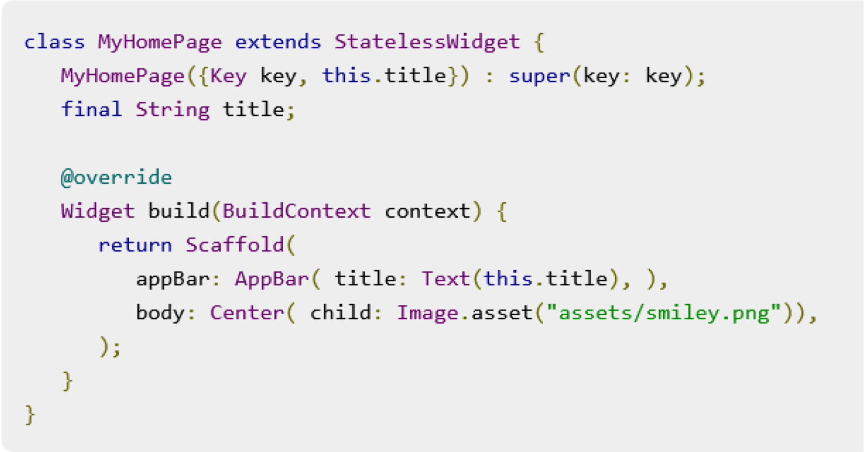
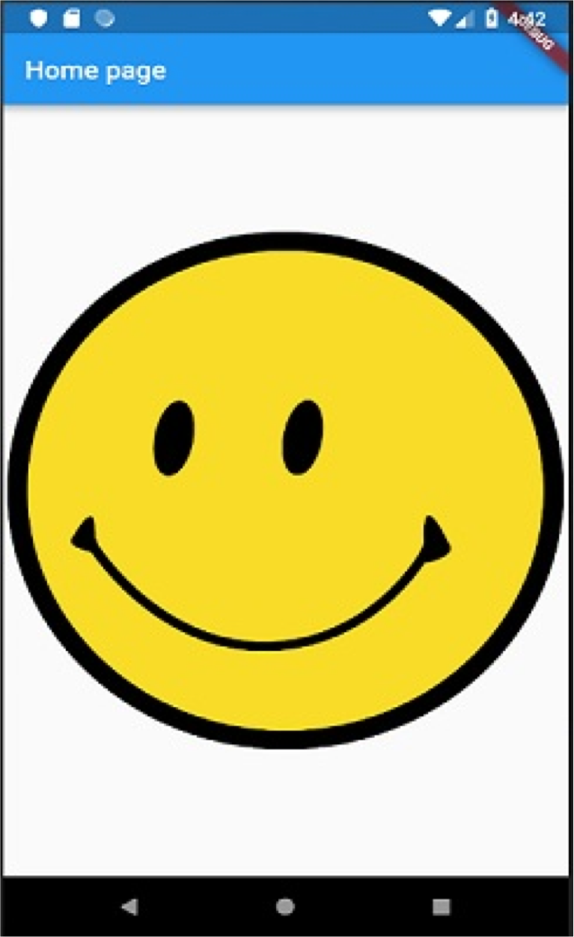
Complete Example

Slide 13

Image
The most important properties of the Image widget are as follows −
image, ImageProvider − Actual image to load
width, double − Width of the image
height, double − Height of the image
alignment, AlignmentGeometry − How to align the image within its bounds

Slide 14

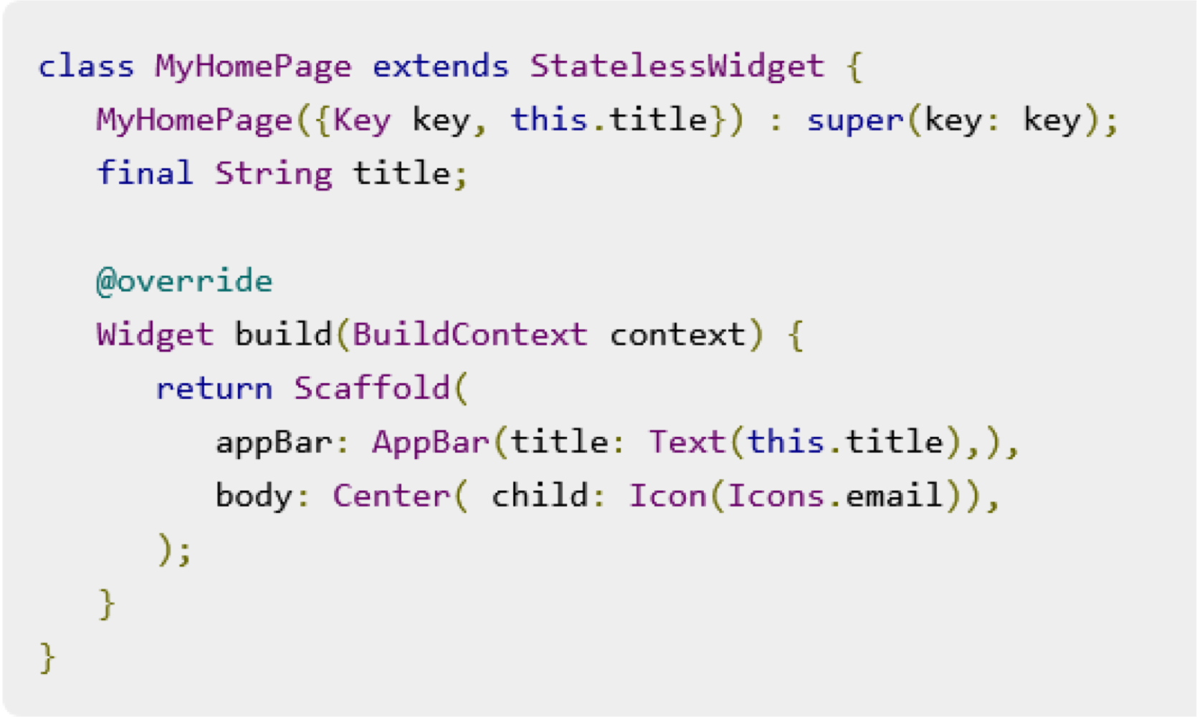
Icon

